Slide 1
Stone Countertops: Which Surface Is Right for Your Next Project?
CASTELLI Marble & Granite
3346 SE Gran Parkway
Stuart, FL 34997
561.203.9293
What You Need to Know to Make Well Informed Decisions

Slide 2
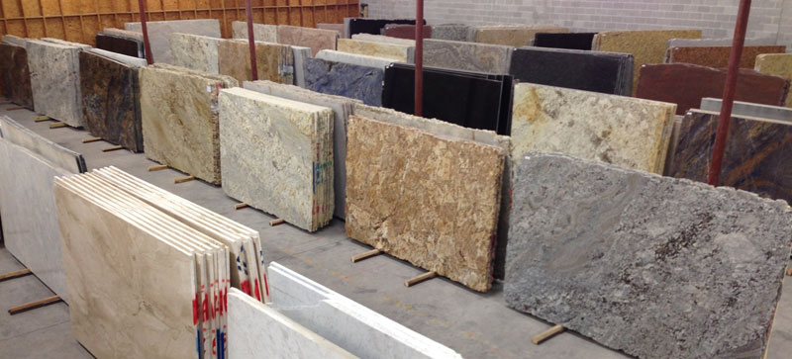
Start To Finish
Initial Considerations:
Application
Where & How your surface will be used
Design Aesthetic
Material color and grain preference
Edge Detail: Simple, Embellished, Mitered
Budget
Deciding how much to spend
With so many options available, cost won’t limit your ability to achieve the look and feel you desire
1. What to Consider
2. Differences in Materials
3. Making the Right Selection
4. Importance of Quality Fabrication

Slide 3
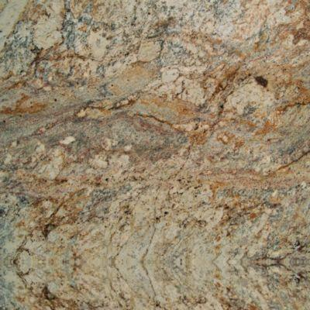
Material Types & Differences
Granite
Quartz
Eco-Practical
An all-natural stone, very hard and stain resistant.
Available in hundreds of colors and grain variations.
Versatile and durable, can be used anywhere in the home or business.
Works well in both interior & exterior applications.
Each slab is a one of a kind with colors and patterns as distinct as the region from which they are mined.
Conventional
An engineered (man-made) stone, very hard and stain resistant.
Available in many monotone consistent colors, as well as, grain patterns reminiscent of natural stone.
Non-porous and durable.
Works well in interiors and away from direct sunlight.
Best suited in modern, minimalist, and conventional aesthetics.

Slide 4
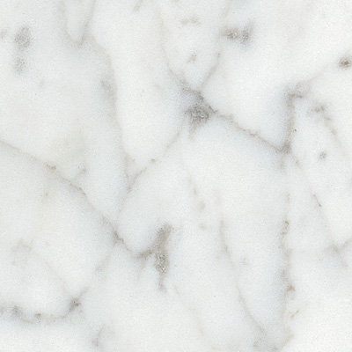
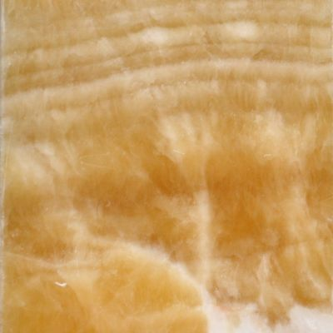
Marble
Quartzite
Onyx
Classic
All natural, soft and porous stone.
Roughly 30-40 color choices.
Can be used anywhere.
Shows wear over time and requires minimal maintenance.
Its beauty is in its distinct veining, as well as the patina it develops from use.
Marble’s look is timeless. A well aged marble countertop is the envy of stone slab enthusiasts.
Luxury
An all-natural, very hard and stain resistant stone.
Fairly new to the market, the hardest material available.
Requires exceptional care and fabrication.
Current color selections are limited to lighter tones with some pattern variations.
Visual crystalline content makes this stone highly sought.
Applications are versatile.
Opulence
All natural, hard yet porous stone.
Susceptible to stains.
Unique characteristics offer stunning visual impact.
Colors range from gold to green, blue, black and more.
Best displayed vertically, on bath and bar walls.
Translucent and often used with back lighting for most dramatic affect.

Slide 5
Product Comparison
Category | Granite | Quartz | Marble | Quartzite | Onyx
Durability | High | High | Moderate | High | Moderate
Selection | Large | Large | Moderate | Moderate | Moderate
Maintenance | Low | Low | Moderate | Low | Low
Stain Risk | Low | Low | High | Low | Moderate
Affordability | Widest Price & Option Range | Moderate Price & Option Range | Moderate Price & Limited Options | High End | High End

Slide 6
What You Can Expect To Pay
Material price is the biggest contributor to overall cost
Granite offers the largest range in pricing
Jobs can start at $40 per Square Foot
Our customers typically spend between $50 - $60 /SF, including materials, fabrication, & installation
Quartz is in high demand and offers a reasonable selection
Jobs can start at $45 /SF
Our customers typically spend between $80 - $90 /SF, including materials, fabrication, & installation
Quartzite is the fastest growing natural stone product available
It’s hardness and crystalline content requires extensive labor & handling, additional fabrication costs should be considered
Our customers typically spend between $75-$120 /SF, including materials, fabrication, & installation

Slide 7
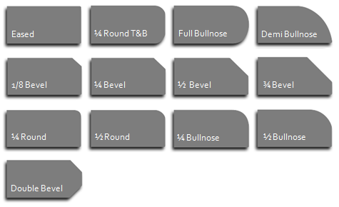
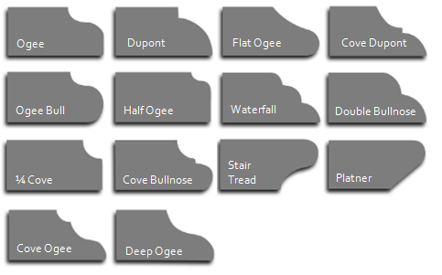
Edge Detail Options
Today’s trend is modest and simple…
Popular
Eased
¼ Round T&B
Full Bullnose
Softened
Ogee
Dupont
Flat Ogee
Cove Dupont
Premium
1/8 Bevel
¼ Bevel
½ Bevel
¾ Bevel
Ogee Bull
Half Ogee
Waterfall
Double Bullnose
¼ Round
½ Round
¼ Bullnose
½ Bullnose
¼ Cove
Full Bevel
Stair
Tread
Platner
Demi Bullnose
Double Bevel
Cove Ogee
Deep Ogee
Cove Bullnose
Ogee
Laminations
1/8 Dupont
Square
Ogee
Ogee
½ Cove
Flat Ogee
Ogee
Cove Dupont
… but the options are endless

Slide 8
Local Business
CASTELLI
Marble & Granite
Serving South Florida Since 2000.
We offer:
Extensive Knowledge & Professionalism
Our time in service and experience level is rare in today’s market.
Reliability & Commitment to Quality
Understanding your unique needs ensures a pleasurable & efficient experience.
Our goal is a product you’ll enjoy and a relationship you’ll recommend.
Industry’s Best Materials
Partnering with our local wholesalers brings you the largest selection available.
Authorized distributors of leading quartz products.
Competitive Pricing
Efficient processes mean less waste; savings we pass on to our customers.
Local wholesaler network ensures the best material prices, everyday.

Slide 9
Authorized to Distribute
www.cambriausa.com
www.pompeiiquartz.com
http://www.caesarstoneus.com
http://www.silestoneusa.com
http://www.lgviaterausa.com

Slide 10
View Our Partners Page
Natural Stone Wholesalers
Spazio Marble & Granite Stuart, West Palm & Lake Worth
Stone Gallery West Palm
Marble Of The World Stuart
UMI Boynton Beach
Omicron West Palm Beach
Keys Granite Boynton Beach
Contract Professionals
Atlantic Cabinetry Jupiter
Interior Finishes by Ron Stuart
Horgan General Contractors Jupiter
The Home Repair Network Stuart
C2 Construction Port St. Lucie
Copeland Construction Jupiter
Legacy Castle Construction North Palm Beach

Slide 11
The Big Box Experience
National retailers bring products, pricing and features to the masses. When choosing the best partner for your project…
Consider these differences:
Knowledge, Experience & Customer Service
Are they capable of considering your unique interests and specific needs?
Do they have industry insight?
Will you speak to the same person as your project progresses?
Are they dedicated to your satisfaction?
Negotiation, Products & Pricing
Who has the authority to work with you if needs or desires change?
Is product selection extensive and competitively priced?
How do ‘add-ons’* affect your bottom line?
Anonymity
Who is responsible for fabrication and installation? Are they credentialed?
Can you be sure you're comfortable before they arrive on site?
* Standard ‘add-ons’ can include radius and bump out edges, sink cut-outs (drop in or under mount), cook top cut-outs, etc.

Slide 12
Contact Us
CASTELLI Marble & Granite
______________________________________________
3346 SE Gran Parkway
Stuart, FL 34997
CastelliMarble@Gmail.com
561.203.9293

